Slide 1


University of Basrah College of Nursing
Management &Leadership in Nursing
Leadership
Lecture three
Prepared by:- assist lect. Hazim naeem waheeb
05/02/2025

Slide 2
Outlines
3. Leadership :
3.1-Definition of leadership and leader
3.2- Characteristics of leader
3.3- Leaders roles
3.4-Leadership theories
3.5-Leadership styles in nursing
3.6-Factors that used to adopt the Leadership Style

Slide 3
Leadership
leadership is the art of motivating a group of people to act towards achieving a common goal.
leader is "a person who influences a group of people towards the achievement of a goal".
A leader must be able to make people willingly want to accomplish something. The leader's job is to get work done by other people.
Effective leadership means effective and productive group performance.

Slide 4
Characteristics of leader
• Leader characteristics will determine behavior e.g.
1- Action-oriented
2- Caring, , Cooperative ,Courageous , Creative, communication
3- Decisive, Dependable, Determined
4-Self-aware, Self-controlled, Self-directed, Self-confident, Self-regulating, Sociable, Supportive

Slide 5
LEADERSHIP ROLES
Guiding
Directing
Teaching
Motivating for goal setting
Motivating for achievement

Slide 6
Leadership Theories
Great Man Theory: This theory claims that leaders are born, not made, suggesting that leadership cannot be developed.
Charismatic Theory: Leaders are likely to set an example by their behavior, communicate nicely to followers and provides motives AND mission.
Trait Theory: Early work in this area asserted that traits are inherited, but later work suggested that traits can be acquired through learning and experience.
Situational Theory: Leaders are likely to set an example by their behavior, communicate nicely to followers and provides motives for the group's mission.

Slide 7
5. Contingency Theory:
The role of the leader: organizing leader-member relationships, position power, and task structuring.
6.Path-Goal Theory
Leader facilitates task completing and rewarding followers for completing their tasks.
7.Transformational leadership
Leaders motivate others through values, vision, and empowerment.
8.Integrative Leadership Model
An integration of leadership theories seems appropriate

Slide 8
Leadership styles in nursing
I: Autocratic style of leadership :The leader assumes complete control over the decisions and activities of the group. The authority for decision making is not delegated to persons in lower level positions.
II: Democratic style of Leadership :This style is characterized by a sense of equality between leaders and followers.
III: Laissez-faire style of leadership:-The leader gives up all power to the group. This encourages independent activity by the group members. An outsider would not be able to identify the leader in such a group.
IV: bureaucratic style. In this style , the leader functions only on lines with rules and regulations. The leader is inflexible and does not like to take any risks.

Slide 9
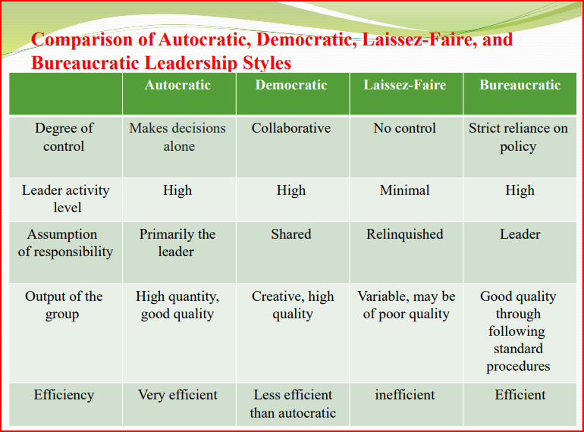
Comparison of Autocratic, Democratic, Laissez-Faire, and Bureaucratic Leadership Styles

Slide 10
Factors that used to adopt the Leadership Style
1. The nature of the work ( lCU, regular unit).
2. The characteristics of nursing staff (knowledge, competencies, attitudes, expectations, etc.).
3. The time available.
4. The importance of the results (output - enhanced quality care).

Slide 11
The qualities of Leader
A: Managerial abilities:
B: Interpersonal Relationship
C: Temperament (Nature or Disposition or character)
D: Credibility and Forward thinking
E: Professionalism
F: Advocate

Slide 12
Manager and Leader
Managers | Leaders
Administrators | Innovators
Relies on control | Inspires trust
Short term plans | Long term plans
Eye on bottom line | Eye on the horizon
Does things right | Does the right thing

Slide 13


Slide 14
REFERENCES
Koontz H &Weihrich H . Essentials of management an international
perspective. (Istedn). New Delhi: Tata McGraw Hill publishers; 2007.
Koontz H &Weihrich H. Management a global perspective. 1st edn. New Delhi: Tata Mc. Graw Hill publishers;2001.
Anthony M K, Theresa S, JoAnn Glick, Martha Duffy and Fran Paschall. Leadership and nurse retention, the pivotal role of nurse managers. JONA. Vol 35, Mar 2005

Slide 15
Home work
define leadership and leader?
different between leader and manager?
Factors that used to adopt the Leadership Style?
How many leadership theories?

Slide 16


